Slide 1


Microsoft Azure Resource Region 2 Region Migration

Slide 2

Microsoft Azure Resource Region 2 Region Migration

Slide 3


Slide 4
Microsoft Azure Resource Region 2 Region Migration

Slide 5
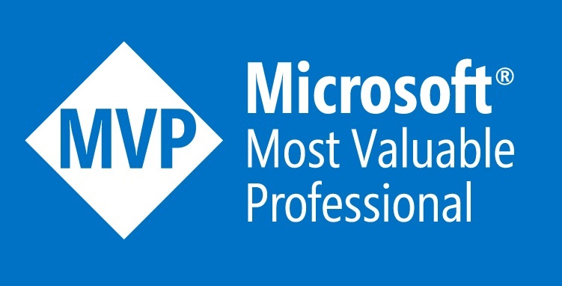
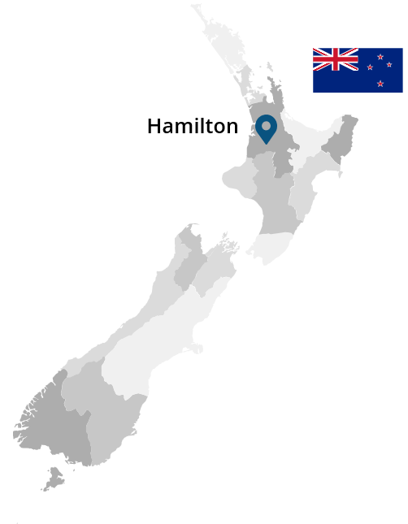
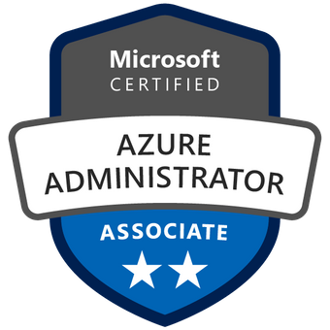


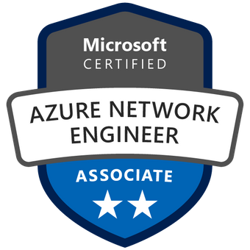



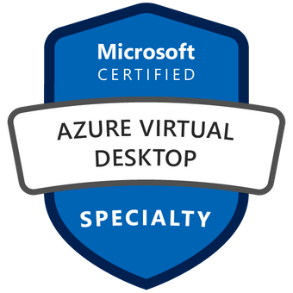
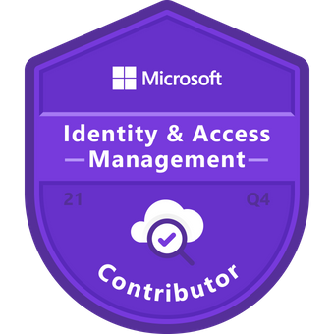
So, who am I?
My name is Luke Murray
Technical Consultant, and newly minted Microsoft MVP from Hamilton, and consumer of Microsoft technologies for more years than I would like to admit.

Slide 6
Microsoft Azure Region to Region Migration
Agenda
What is an Azure region, anyway? How can I migrate already existing resources?

Slide 7
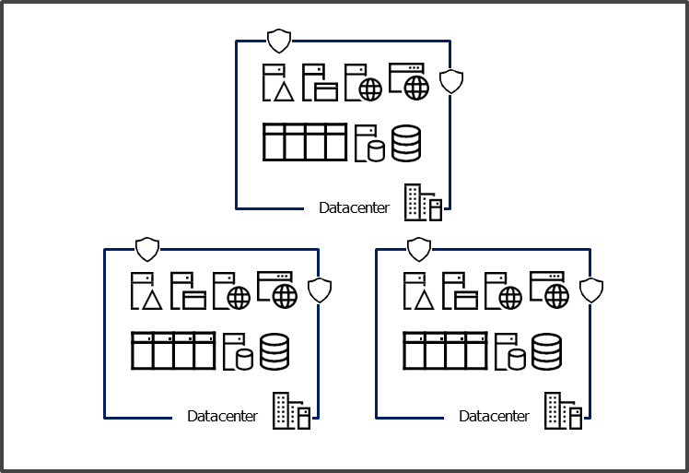
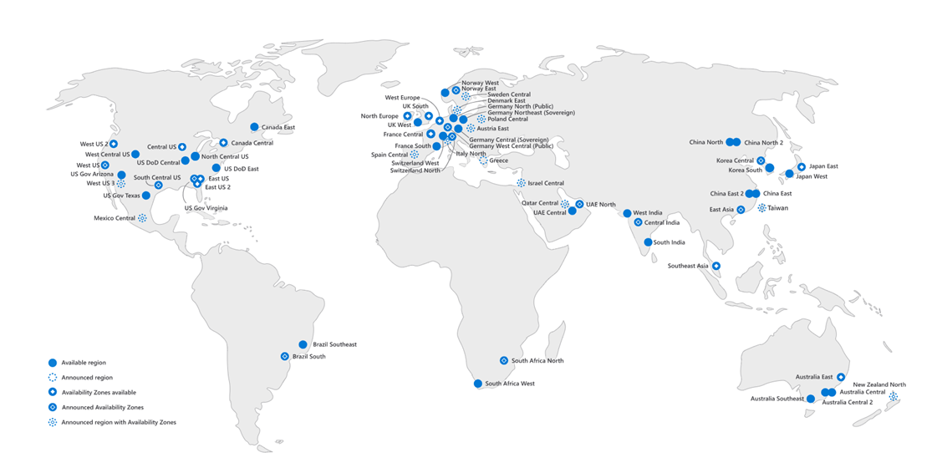
Australia East
What is a region?

Slide 8
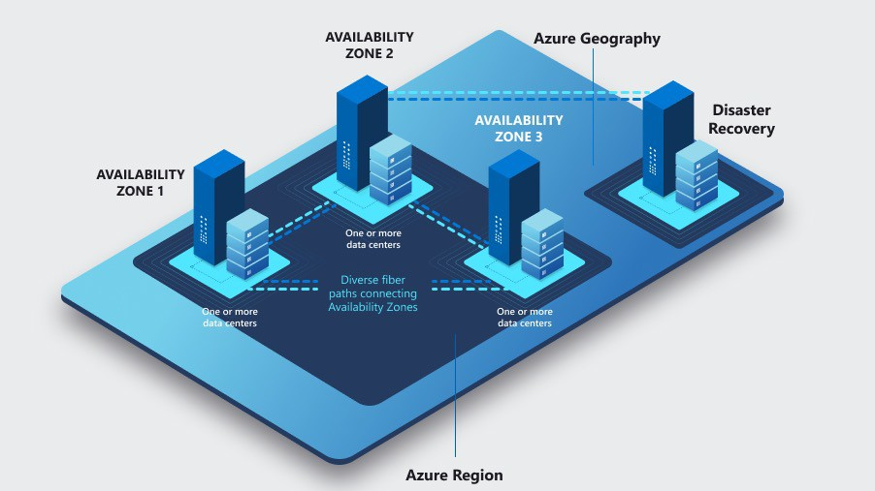
Availability Zones have…
What is an availability zone?
Independent:
POWER
NETWORK
COOLING
2ms latency maximum
One or more data centers
Different between Subscriptions

Slide 9
With availability groups within a region, what type of services can utilise them?
Zonal services
Zone-redundant services
Always-available services (non-regional/GRS & Global)
deployed to a specific, self-selected AZ to achieve latency or performance requirements (i.e., Azure Storage as LRS (Locally Redundant) or Basic Azure Load Balancer)
3 copies within the same availability zone (i.e., Azure storage account data copied 3 times in the same zone)
resources can be pinned to a specific zone
resources are replicated or distributed across zones automatically (i.e., Azure Storage as ZRS (Zone Redundant) or Standard Azure Load Balancer)
failure in one zone doesn't affect the high availability of the data, so recommended for key Azure services, such as Azure Firewall, Expressroute.
always available across all Azure geographies and are resilient to zone-wide outages and region-wide outages (i.e., Geo zone redundant such as a Cosmos Database with Secondary region replica or Global such as Azure Active Directory and Azure DNS)
3 copies within the same region (i.e., Azure storage account data is copied 3 times, but one copy in each availability zone)
3 copies when the same region (i.e., Geo one-redundant service (GZRS) and + 3 copies in a single availability zone in a secondary region)

Slide 10
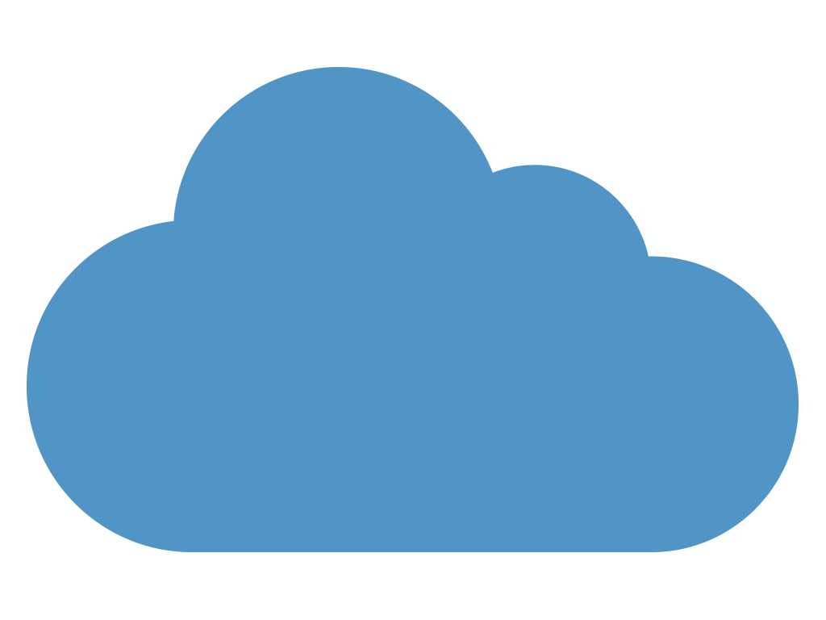
KEEP
CALM
AND
MIGRATE IT IN AZURE
Azure Resource Mover

Slide 11
Why would I migrate resources?
Why?
Taking advantage of new Azure region expansions (i.e., NZ North) to be closer to customers and reduce latency.
Increasing availability and resilience by moving to Azure Availability Zones, from regions that don’t support it.
Meeting data residency and compliance requirements.
Consolidating workloads for mergers and acquisitions.
The cost of resources in one region may be cheaper than another.

Slide 12
Risks of would I migrate resources?
What are the risks of migrating resources?
Whatever your reason, moving your applications from Point A to Point B is often no easy task. Here are common reasons why:
Moving resources can pose risk of outage.
Workloads are often made up of multiple services, each requiring their own method and tools to move.
Interdependencies are often not understood.
Testing and rollback of these complex scenarios can be daunting.

Slide 13


Benefits of using Azure Resource Mover?
Move with confidence
Plan with ease
Orchestrate seamlessly
Orchestrate your move within a highly secure and encrypted Azure environment.
Streamline your move process by identifying dependencies
Move multiple resources through a single pane of glass
Plan and test your move multiple times
Stage your move as part of a scheduled downtime
Reduce manual touchpoints
Reduce overall time for your move from months to weeks or days (based on amount of data)
Validate your move before final commitment.
Get peace of mind with source resources left intact until the move is complete.

Slide 14
What are the key capabilities of Azure Resource Mover?
Unified experience
Validate dependencies
Edit target config settings
Move different type of resource via the same move experience and steps
Check whether resources have any dependencies that aren't in the move collection
Modify resource settings e.g.: Name, SKU, Availability zones etc.
Select multiple resources and perform delete operation simultaneously in a single step

Slide 15
What can Azure Resource Mover move?
What?
Azure SQL Database (but not Azure SQL Server)
Azure Virtual Network
SQL elastic pools
Load balancer (both Internal and Public)
Public IP
Resource group
Network security group
Network interface
Azure Availability Sets
Azure Storage Account (next 6-9 months)
Azure Virtual Machines and associated disks (but not unattached/unassociated disks)

Slide 16
Move region process
The move region 6 step process
Select Resources
Resources you select are added to a move collection.
Validate dependencies
Resource Mover checks whether resources in the move collection have dependencies on other resources.
Validation repeats until there are no outstanding dependencies.
Prepare to Move
For stateless resources, an Azure Resource Manager (ARM) template is generated.
For stateful resources, preparation might include replicating the resource to the target region.
Initiate Move
For stateless resources, the ARM template is deployed in the target region.
For stateful resources, initiative might create the resource, or enable a copy, in the target region. There might be some downtime.
Commit or discard Move
To complete the move, you commit it.
If you don't want to go ahead with the move, you can discard it.
Delete source
After completing the move, you can delete the resources in the source region.
Potential Outage impacting

Slide 17
Let us see Azure Resource Mover in action?

Slide 18
Australia East
Region to region?
West US 3

Slide 19
Region to region?
What resources are we going to migrate?
Virtual Network Azure SQL Database Azure Virtual Machine & associated dependencies (Resource Groups, Network Interfaces, Managed Disks) Note: The migration time took around roughly 1 hour for end-to-end migration. Demo was pre-recorded to fit within session limit.

Slide 20
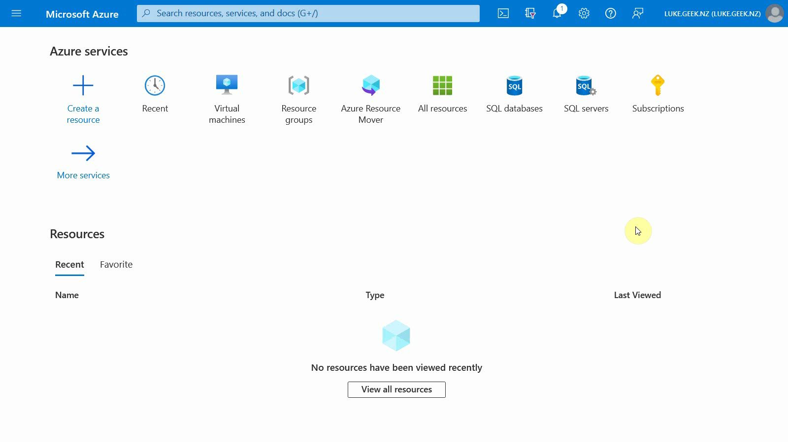

Slide 21
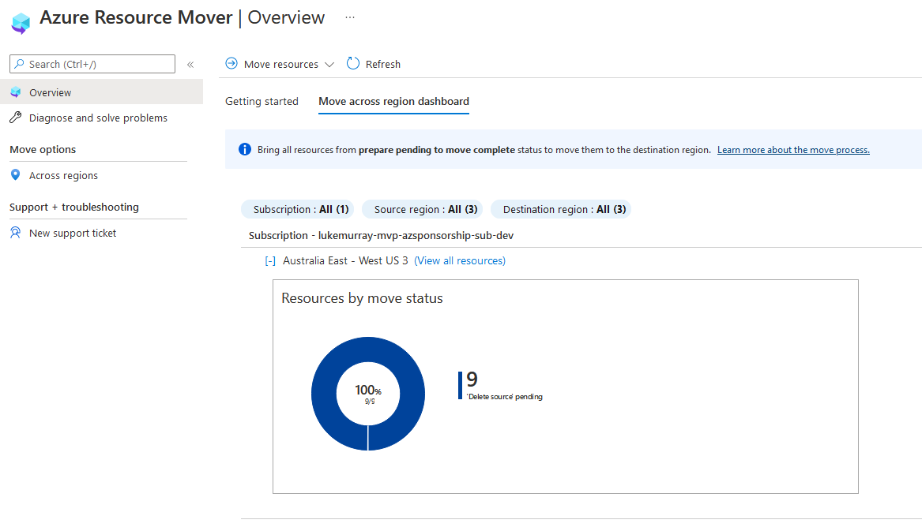

Slide 22
What can Azure Resource Mover move?
Some items to note?
You can't select individual disks as resources to the moved across regions. However, disks are moved as part of a VM move.
You can move resources to another subscription AFTER moving resources to the destination region.
You cannot move peered Virtual Networks across subscriptions, you need to remove the peering first, then readd it back in the destination region.
Azure Resource Mover can be used to migrate Azure Virtual Desktop session hosts across regions.
You can migrate encrypted Virtual Machines, but needs manual intervention to copy the keys
Make sure your quota and required services have been registered and increased for the additional region
There are PowerShell cmdlets (i.e., New-AzResourceMoverMoveCollection)
DNS records can be key to reducing the complexity and interruption to end users as part of your migration.

Slide 23
Multi-region Load balancers

Slide 24
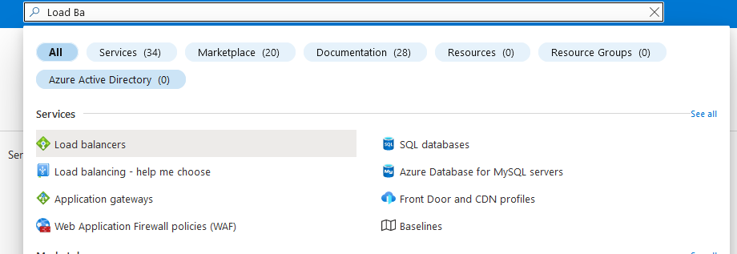

Slide 25
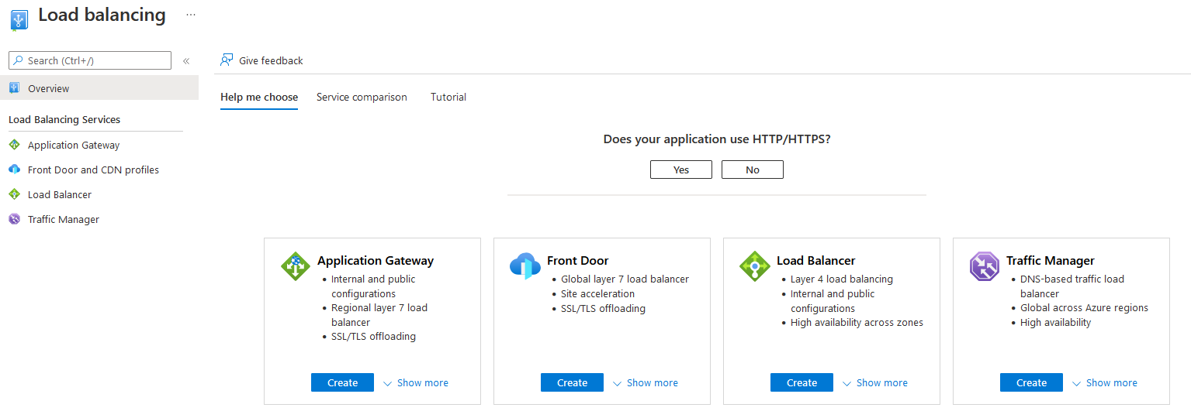

Slide 26
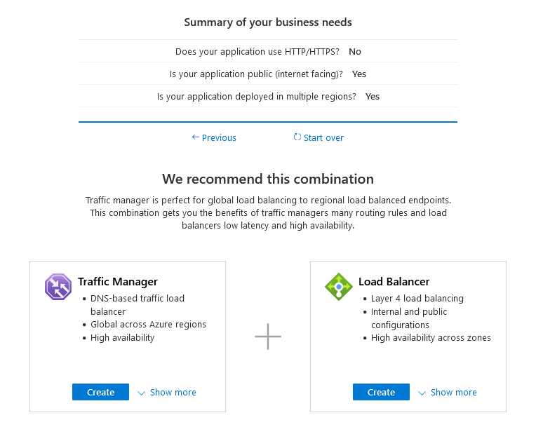
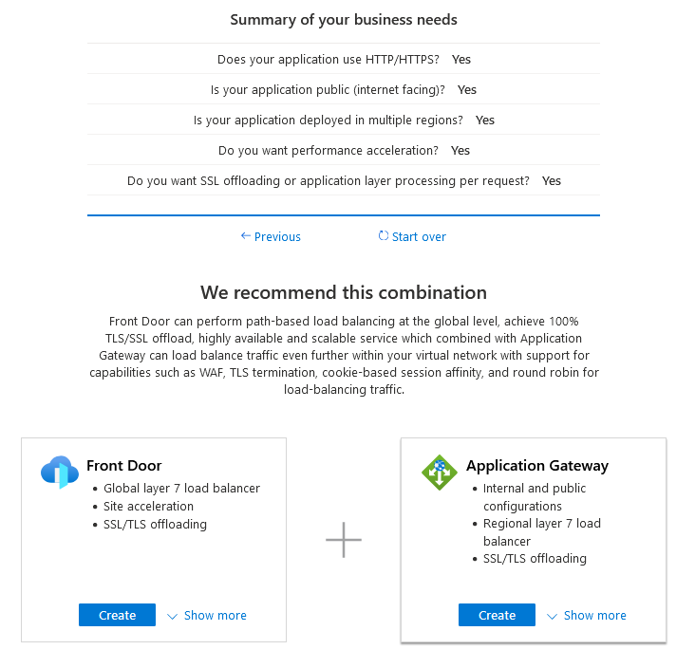

Slide 27



Australia East
Region to region?
Internet/On-premises
Australia Southeast

Slide 28
Additional Resources
Thank you! Here are some additional resources to learn more about Microsoft Azure and Azure regions
Azure Architecture center
Load-balancing options
Azure geographies
Azure Storage redundancy
Azure cross-region replication pairings
AWESOME-Azure-Architecture GitHub List
Support for moving Azure VMs between Azure regions

Slide 29
Additional Resources
Thank you! Here are some additional resources to learn more about Azure Resource Mover
To learn more about Azure Resource Mover, visit the Azure Resource Mover page.
azure.microsoft.com/services/resource-mover
Preview how you can move resources across regions with Azure Resource Mover.
docs.microsoft.com/azure/resource-mover/overview
Azure Resource Mover videos:
Azure Unblogged - Azure Resource Mover (microsoft.com)
Azure Friday Video
Azure Resource Mover whiteboarding video

Slide 30
Azure Region Portability Program (ARPP)
The Azure Region Portability Program (ARPP) coordinates tools, resources, teams, and partners to facilitate migration of cloud workloads between different geographical regions, addressing both technical and business requirements.
See your local Microsoft Customer Success Manager

Slide 31

THANK YOU!
“Bring on NZ North!“
Thanks to Microsoft Reactor team,
Microsoft New Zealand & the community for making this event a possibility.
The slide deck can be found on my GitHub page
Follow the QR code to link to my Linktree

